Slide 1
Pushdown Automata(PDA)
Pushdown automata is a way to implement a CFG in the same way we design DFA for a regular grammar. A DFA can remember a finite amount of information, but a PDA can remember an infinite amount of information.
Pushdown automata is simply an NFA augmented with an "external stack memory". The addition of stack is used to provide a last-in-first-out memory management capability to Pushdown automata. Pushdown automata can store an unbounded amount of information on the stack. It can access a limited amount of information on the stack. A PDA can push an element onto the top of the stack and pop off an element from the top of the stack. To read an element into the stack, the top elements must be popped off and are lost.
A PDA is more powerful than FA. Any language which can be acceptable by FA can also be acceptable by PDA. PDA also accepts a class of language which even cannot be accepted by FA. Thus PDA is much more superior to FA.

Slide 2
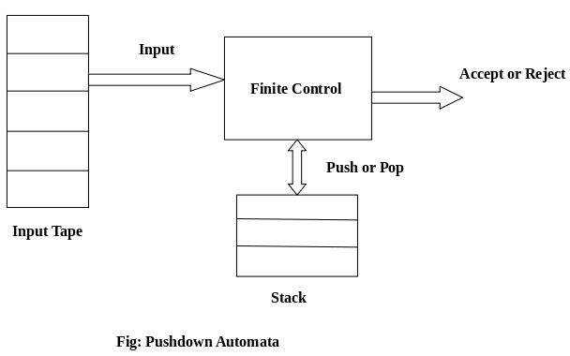
Pushdown Automata(PDA)

Slide 3
Pushdown Automata(PDA)
PDA Components:
Input tape: The input tape is divided in many cells or symbols. The input head is read-only and may only move from left to right, one symbol at a time.
Finite control: The finite control has some pointer which points the current symbol which is to be read.
Stack: The stack is a structure in which we can push and remove the items from one end only. It has an infinite size. In PDA, the stack is used to store the items temporarily.

Slide 4
Formal definition of PDA: The PDA can be defined as a collection of 7 components:
Q: the finite set of states
∑: the input set
Γ: a stack symbol which can be pushed and popped from the stack
q0: the initial state
Z: a start symbol which is in Γ.
F: a set of final states
δ: mapping function which is used for moving from current state to next state.

Slide 5
Instantaneous Description (ID)
ID is an informal notation of how a PDA computes an input string and make a decision that string is accepted or rejected.
An instantaneous description is a triple (q, w, α) where:
q describes the current state.
w describes the remaining input.
α describes the stack contents, top at the left.
Turnstile Notation:
⊢ sign describes the turnstile notation and represents one move.
⊢* sign describes a sequence of moves.

Slide 6
For example, (p, b, T) ⊢ (q, w, α) In the above example, while taking a transition from state p to q, the input symbol 'b' is consumed, and the top of the stack 'T' is represented by a new string α.
Example 1:
Design a PDA for accepting a language {a^{n}b^{2n} | n>=1}.
Solution: In this language, n number of a's should be followed by 2n number of b's. Hence, we will apply a very simple logic, and that is if we read single 'a', we will push two a's onto the stack. As soon as we read 'b' then for every single 'b' only one 'a' should get popped from the stack.
The ID can be constructed as follows:
δ(q0, a, Z) = (q0, aaZ)
δ(q0, a, a) = (q0, aaa)
Now when we read b, we will change the state from q0 to q1 and start popping corresponding 'a'. Hence,
δ(q0, b, a) = (q1, ε)

Slide 7
Thus this process of popping 'b' will be repeated unless all the symbols are read. Note that popping action occurs in state q1 only.
δ(q1, b, a) = (q1, ε)
After reading all b's, all the corresponding a's should get popped. Hence when we read ε as input symbol then there should be nothing in the stack. Hence the move will be:
δ(q1, ε, Z) = (q2, ε)
Where,
PDA = ({q0, q1, q2}, {a, b}, {a, Z}, δ, q0, Z, {q2})

Slide 8
We can summarize the ID as:
δ(q0, a, Z) = (q0, aaZ)
δ(q0, a, a) = (q0, aaa)
δ(q0, b, a) = (q1, ε)
δ(q1, b, a) = (q1, ε)
δ(q1, ε, Z) = (q2, ε)
Now we will simulate this PDA for the input string "aaabbbbbb".

Slide 9
δ(q0, aaabbbbbb, Z) ⊢ δ(q0, aabbbbbb, aaZ)
⊢ δ(q0, abbbbbb, aaaaZ)
⊢ δ(q0, bbbbbb, aaaaaaZ)
⊢ δ(q1, bbbbb, aaaaaZ)
⊢ δ(q1, bbbb, aaaaZ)
⊢ δ(q1, bbb, aaaZ)
⊢ δ(q1, bb, aaZ)
⊢ δ(q1, b, aZ)
⊢ δ(q1, ε, Z)
⊢ δ(q2, ε)
ACCEPT

Slide 10
PDA Acceptance: A language can be accepted by Pushdown automata using two approaches:
1. Acceptance by Final State: The PDA is said to accept its input by the final state if it enters any final state in zero or more moves after reading the entire input.
Let P =(Q, ∑, Γ, δ, q0, Z, F) be a PDA. The language acceptable by the final state can be defined as:
L(PDA) = {w | (q0, w, Z) ⊢* (p, ε, ε), q ∈ F}
2. Acceptance by Empty Stack: On reading the input string from the initial configuration for some PDA, the stack of PDA gets empty.
Let P =(Q, ∑, Γ, δ, q0, Z, F) be a PDA. The language acceptable by empty stack can be defined as:
N(PDA) = {w | (q0, w, Z) ⊢* (p, ε, ε), q ∈ Q}

Slide 11
Equivalence of Acceptance by Final State and Empty Stack
If L = N(P1) for some PDA P1, then there is a PDA P2 such that L = L(P2). That means the language accepted by empty stack PDA will also be accepted by final state PDA.
If there is a language L = L (P1) for some PDA P1 then there is a PDA P2 such that L = N(P2). That means language accepted by final state PDA is also acceptable by empty stack PDA.

Slide 12
Example: Construct a PDA that accepts the language L over {0, 1} by empty stack which accepts all the string of 0's and 1's in which a number of 0's are twice of number of 1's.
Solution:
There are two parts for designing this PDA:
If 1 comes before any 0's
If 0 comes before any 1's.
We are going to design the first part i.e. 1 comes before 0's. The logic is that read single 1 and push two 1's onto the stack. Thereafter on reading two 0's, POP two 1's from the stack. The δ can be
δ(q0, 1, Z) = (q0, 11, Z) Here Z represents that stack is empty
δ(q0, 0, 1) = (q0, ε)

Slide 13
Now, consider the second part i.e. if 0 comes before 1's. The logic is that read first 0, push it onto the stack and change state from q0 to q1. [Note that state q1 indicates that first 0 is read and still second 0 has yet to read].
Being in q1, if 1 is encountered then POP 0. Being in q1, if 0 is read then simply read that second 0 and move ahead. The δ will be:
δ(q0, 0, Z) = (q1, 0Z)
δ(q1, 0, 0) = (q1, 0)
δ(q1, 0, Z) = (q0, ε) (indicate that one 0 and one 1 is already read, so simply read the second 0)
δ(q1, 1, 0) = (q1, ε)
Now, summarize the complete PDA for given L is:
δ(q0, 1, Z) = (q0, 11Z)
δ(q0, 0, 1) = (q1, ε)
δ(q0, 0, Z) = (q1, 0Z)
δ(q1, 0, 0) = (q1, 0)
δ(q1, 0, Z) = (q0, ε)
δ(q0, ε, Z) = (q0, ε) ACCEPT state

Slide 14
Non-deterministic Pushdown Automata
The non-deterministic pushdown automata is very much similar to NFA. We will discuss some CFGs which accepts NPDA.
The CFG which accepts deterministic PDA accepts non-deterministic PDAs as well. Similarly, there are some CFGs which can be accepted only by NPDA and not by DPDA. Thus NPDA is more powerful than DPDA.
Example:
Design PDA for Palindrome strips.
Solution:
Suppose the language consists of string L = {aba, aa, bb, bab, bbabb, aabaa, ......]. The string can be odd palindrome or even palindrome. The logic for constructing PDA is that we will push a symbol onto the stack till half of the string then we will read each symbol and then perform the pop operation. We will compare to see whether the symbol which is popped is similar to the symbol which is read. Whether we reach to end of the input, we expect the stack to be empty.
This PDA is a non-deterministic PDA because finding the mid for the given string and reading the string from left and matching it with from right (reverse) direction leads to non-deterministic moves. Here is the ID.

Slide 15
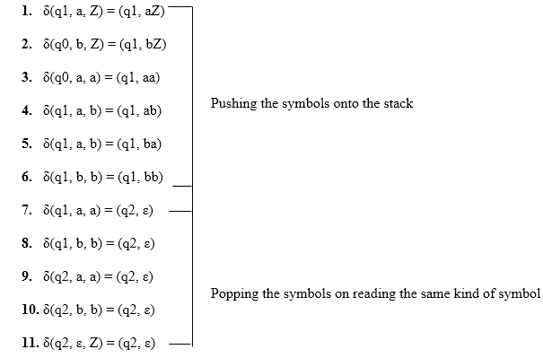

Slide 16
Simulation of abaaba
δ(q1, abaaba, Z) Apply rule 1
⊢ δ(q1, baaba, aZ) Apply rule 5
⊢ δ(q1, aaba, baZ) Apply rule 4
⊢ δ(q1, aba, abaZ) Apply rule 7
⊢ δ(q2, ba, baZ) Apply rule 8
⊢ δ(q2, a, aZ) Apply rule 7
⊢ δ(q2, ε, Z) Apply rule 11
⊢ δ(q2, ε) Accept

Slide 17
https://www.javatpoint.com/automata-cfg-to-pda-conversion

Slide 18
PDA to CFG
δ(q_{0 ,} a , Z₀) = (q_{0 ,} aZ₀)
δ(q_{0 ,} a , a) = (q_{0 ,} aa)
δ(q_{0 ,} b , a) = (q_{1 ,} a)
δ(q_{1 ,} b, a) = (q_{1 ,} a)
δ(q_{1 ,} a , a) = (q_{1 , €})
δ(q_{1,} €, Z₀) = (q_{1 ,} €)

Slide 19
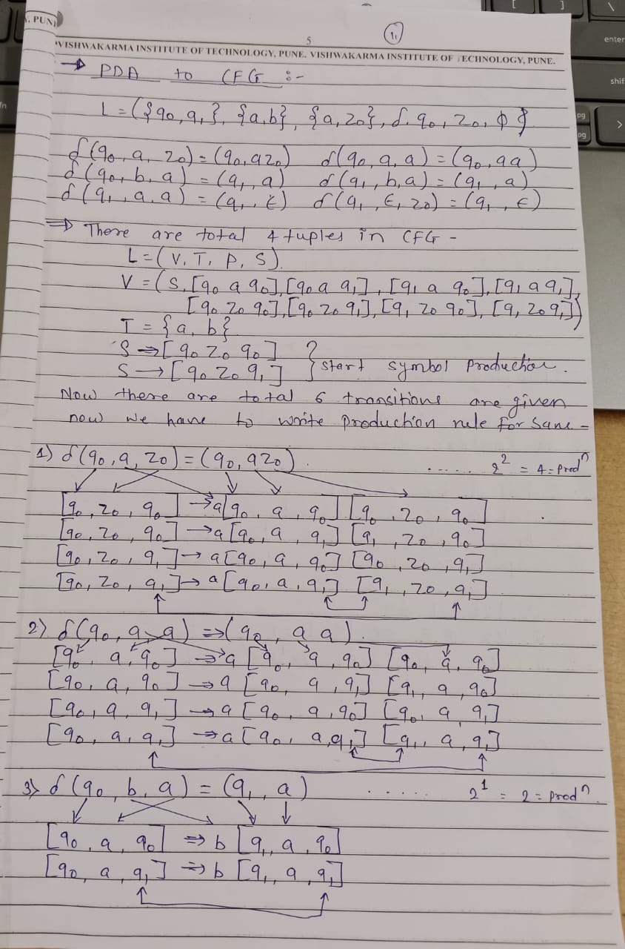
PDA to CFG

Slide 20
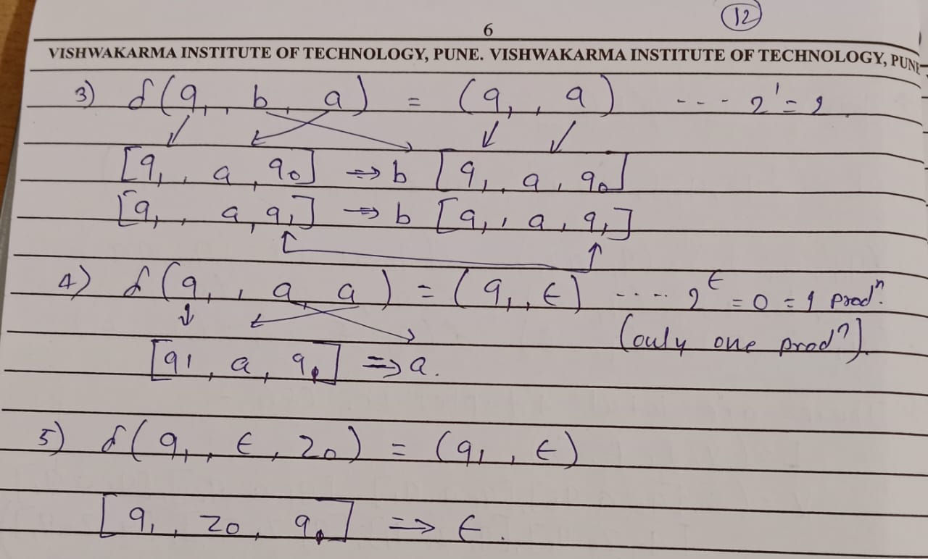

Slide 21
Closure Properties of Context Free Languages
1) Union : If L1 and L2 are two context free languages, their union L1 ? L2 will also be context free. For example, L1 = { a^{n}b^{n}c^{m} | m >= 0 and n >= 0 } and L2 = { a^{n}b^{m}c^{m} | n >= 0 and m >= 0 } L3 = L1 ? L2 = { a^{n}b^{n}c^{m} ? a^{n}b^{m}c^{m} | n >= 0, m >= 0 } is also context free. L1 says number of a’s should be equal to number of b’s and L2 says number of b’s should be equal to number of c’s. Their union says either of two conditions to be true. So it is also context free language.
Note: So CFL are closed under Union.

Slide 22
2) Concatenation : If L1 and If L2 are two context free languages, their concatenation L1.L2 will also be context free. For example, L1 = { a^{n}b^{n} | n >= 0 } and L2 = { c^{m}d^{m} | m >= 0 } L3 = L1.L2 = { a^{n}b^{n}c^{m}d^{m} | m >= 0 and n >= 0} is also context free.
L1 says number of a’s should be equal to number of b’s and L2 says number of c’s should be equal to number of d’s. Their concatenation says first number of a’s should be equal to number of b’s, then number of c’s should be equal to number of d’s. So, we can create a PDA which will first push for a’s, pop for b’s, push for c’s then pop for d’s. So it can be accepted by pushdown automata, hence context free.
Note: So CFL are closed under Concatenation.
3) Kleene Closure : If L1 is context free, its Kleene closure L1* will also be context free. For example, L1 = { a^{n}b^{n} | n >= 0 } L1* = { a^{n}b^{n} | n >= 0 }* is also context free.
Note :So CFL are closed under Kleen Closure.

Slide 23
4) Intersection and complementation : If L1 and If L2 are two context free languages, their intersection L1 ? L2 need not be context free. For example, L1 = { a^{n}b^{n}c^{m} | n >= 0 and m >= 0 } and L2 = (a^{m}b^{n}c^{n} | n >= 0 and m >= 0 } L3 = L1 ? L2 = { a^{n}b^{n}c^{n} | n >= 0 } need not be context free.
L1 says number of a’s should be equal to number of b’s and L2 says number of b’s should be equal to number of c’s. Their intersection says both conditions need to be true, but push down automata can compare only two. So it cannot be accepted by pushdown automata, hence not context free. Similarly, complementation of context free language L1 which is ?* – L1, need not be context free.
Note : So CFL are not closed under Intersection and Complementation.

Slide 24
Pumping lemma for context free language
Pumping lemma for context free language (CFL) is used to prove that a language is not a Context free language
Assume L is context free language
Then there is a pumping length n such that any string w εL of length>=n can be written as follows −
|w|>=n
We can break w into 5 strings, w=uvxyz, such as the ones given below
|vxy| >=n
|vy| # ε
For all k>=0, the string uv^{k}xy^{y}z∈L

Slide 25
The steps to prove that the language is not a context free by using pumping lemma are explained below −
Assume that L is context free.
The pumping length is n.
All strings longer than n can be pumped |w|>=n.
Now find a string 'w' in L such that |w|>=n.
Divide w into uvxyz
Show that uv^{k}xy^{k}z ∉L for some k
Then, consider the ways that w can be divided into uvxyz.
Show that none of these can satisfy all the 3 pumping conditions at same time.
w cannot be pumped.

Slide 26
Example Find out whether L={x^{n}yn^{z}n|n>=1} is context free or not Solution:
Let L be context free.
L must satisfy pumping length, say n.
Now we can take a string such that s=x^{n}y^{n}z^{n}
We divide s into 5 strings uvxyz.
Let n=4 so, s=x⁴y⁴z⁴

Slide 27
Case 1:
v and y each contain only one type of symbol.
{we are considering only v and y because v and y has power uv²xy²z}
X xx x yyyyz z zz
=uv^{k}xy^{k}z when k=2
=uv²xy²z
=xxxxxxyyyyzzzzz
=x⁶y⁴z⁵
(Number of x # number of y #number of z)
Therefore,The resultant string is not satisfying the condition
x⁶y⁴z⁵ ∉ L
If one case fails then no need to check another condition.

Slide 28
Case 2:
Either v or y has more than one kind of symbols
Xx xx yy y y zzzz
=uv^{k}xy^{k}z (k=2)
=uv²xy²z
=xxxxyyxxyyyyyzzzz
=x⁴y²x²y⁵z²
This string is not following the pattern of our string x^{n}y^{n}z^{n}

